Slide 1

Our Working System
Leyzan
Esma
Testing
İmplementation
Evaluation
Kadir
Analysis
Design
Anjel
Asude
https://github.com/HAS-Project/Hospital-Appointment-System
Hello, we are the has project team. Our goal is not to assign individual tasks to everyone, but to help everyone understand the same task. In our working system, everyone can get help from each other and a common decision can be taken as a group on a single issue. The main goal is to have teammates involved in all phases of the project so that everyone is not focused on one issue and can be active in many phases of the project. In this way, everyone can use their ideas and skills together, common decisions as a team, common ideas, collaborative working order can make the project better. As a result, we found this working model suitable for ourselves. We made our task distribution according to ourselves and adopted the matrix business model.

Slide 2
Why online hospital appointment system?
Epidemic diseases that have become widespread in recent years have brought many dangers. As infectious diseases endanger people's lives, the importance of online and contactless transactions began to be understood. Most hospitals needed an online appointment system because it could increase the risk of epidemics in making an appointment with the hospital due to epidemics. The online appointment system allows people to make an appointment online without contacting anyone else. Therefore, many patients found it healthier to make an appointment online without going to the hospital. Due to the increasing epidemic in recent years, hospitals that have switched to online appointment system need a more advanced, easier and understandable appointment system. Most patients using online appointment systems have difficulty in finding the department related to their illness, they waste too much time searching for the department or cannot find the department they are looking for. That's why we aimed to develop our own online hospital appointment system. With the online Has project, patients can easily find the section related to their diseases with keywords and can easily make an appointment. With its user-friendly and simple interface, you can connect to the system via the internet with the device you want and make an appointment easily.

Slide 3
Hospital Appointment System
ONLINE
Software language: HTML - PHP – SQL - CSS
Softwares: Apache - MySQL - phpMyAdmin
Operating Environment: Web.
Project features
There will be a system of hospitals, doctors and specialists.
Every hospital has doctors and every doctor has specialties.
The patient will log into the system with a complaint.
After preliminary questions, specialties related to patient complaints will be listed
The system lists and ranks the hospitals with this specialization and the doctors of these hospitals.
The patient will be able to make an appointment.

Slide 4
başla
N
Y
kayıtlı
giriş
Kayıt ol
Hasta bilgileri
Randevu işlemi
İl tercihi
İlçe tercihi
Şikayet girişi
Doktor, Bölüm ve Hastane
CONFİRM
Y
Randevu saati seçimi
Randevu
Sil/ekle
Randevu bilgisi
END
N
bitir

Slide 5
Use Case Diyagram
-less details-
Name of the use case: Hospital Appointment System-HAS online
Actors: Patients
Goals : Patients want to make an appointment easily by entering their complaints about their diseases into the system.
Preconditions: The web page must be entered. Related conditions; user registration (user information), province, district, patient complaint, appointment date and time.
Steps:
The user opens the web page to make an appointment.
The user can log in or sign up to make an appointment..
After logging into the system, the user comes to the section search section.
The user enters the province, district and complaint information in the section search section.
After the user enters her complaint, the department, hospital and doctor related to her complaint come.
The user selects the appointment time and date.
After the user has determined the date and time of the appointment, the message "Your appointment has been added" appears on the screen.
The user can see the appointment in the "My appointment information" section and delete the registered appointment.
The user can log out after making an appointment.
Post conditions:The user's user information and appointment information are added to the system.

Slide 6
Use Case Diyagram
Name of the use case: Hospital Appointment System-HAS-
Actors: Patients
Goals : Patients want to make an appointment easily by entering their complaints about their diseases into the system.
Preconditions: The web page must be entered. Related conditions; user registration (user information), province, district, patient complaint, appointment date and time.
Aktör actions:
System responses:
1-User open web page.
3- The sign up page(sign.php) opens
2-The user can sign up
4-User enters user information and clicks the sign in button.
5- The login page opens
(index.php)
6-The user logs in with their credential and password.
7- The appointment page opens(randevu.php)
8- The user writes their complaints after selecting the province and district.
9- In line with the information entered by the user, the hospital doctor and department are displayed on the screen.
10-The user can choose one of the options that appear on the screen in line with her complaint
12-"Your appointment has been added" message appears on the screen.
11-The user selects the appointment date and time.
14-Back to the login page.
13-The user can log out via the log out link.
16-Displays the message that the user session has been cleared..
15-clears the user session
Post conditions: The user's user information and appointment information are added to the system.

Slide 7
Use Case Diyagram
-graphic-
< Hospital Appointment System >
Web page
PATIENT(User)
Register
HAS-PROJECT
make an appointment
Hospitals, Doctors, Departments
View or delete an appointment.
(Admin)
Can add and delete hospitals, doctors or departments.
can access and repair the database.

Slide 8
Sequence Diyagram
sd Online_HospitalAppointmentSystem
:Web Patient
: Online
Hospital Appointment System
loop
search for an appointment based on your complaint
appointment results regarding the complaint
opt
Appointment selection by hospital, doctor, department
opt
Appointment date and time selection
opt
ref
log out of the system

Slide 9
MODULES
Hospital System
Bölümler
Doktorlar
Hasta
Hastaneler
il
ilçe
Randevu
Saatler

Slide 10
Bölümler
Doktorlar
BölümID
BölümADI
BölümTAGS
DoktorID
DoktorDERECE
DoktorNO
DoktorADI
DoktorSOYADI
BölümADI
HastaneADI
DoktorCİNSİYET
Hasta
HastaID
HastaADI
HastaSOYADI
HastaPASSWORD
HastailName
HastaDOGUMTARIHI
HastaKANGURUBU
HastaCİNSİYETİ
Hastaneler
HastaneID
HastaneADI
HastaneIL
HastaILCE
HastaneDURUMU
HastaneADRESI
HastaneTEL
il
ILID
ILKODU
ILADI
ilçe
Randevu
İlçeID
İlçeADI
İlçeKEY
İlçeKODU
RandevuID
RandevuSaat
RandevuilAdı
RandevuilçeAdı
RandevuHastaneAd
RandevuBölümADI
RandevuDoktorName
RandevuDoktorSurme
RandevuCONTROL
Saatler
9:00-16:00

Slide 11
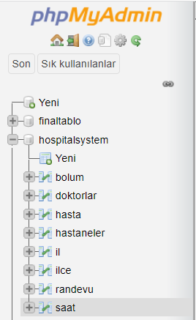
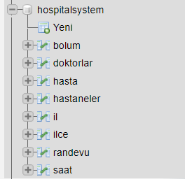
Our database and tables.

Slide 12
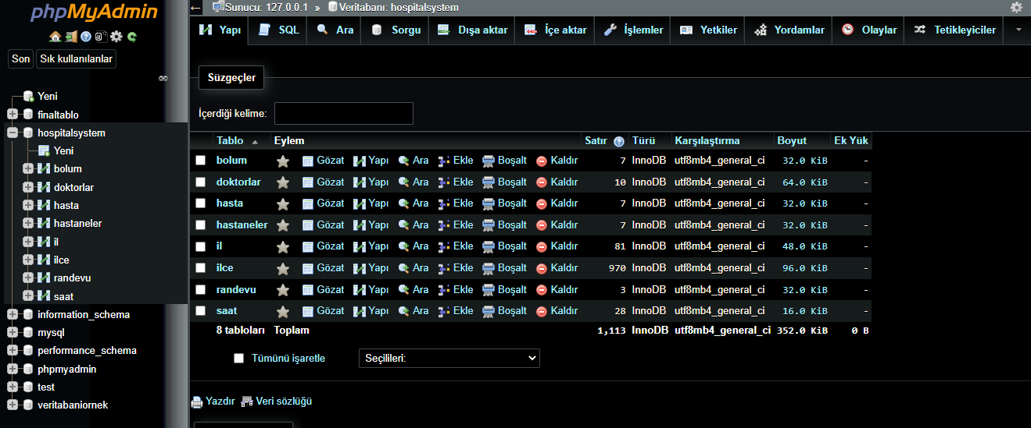
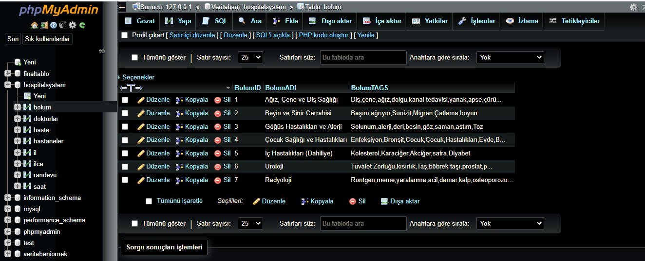
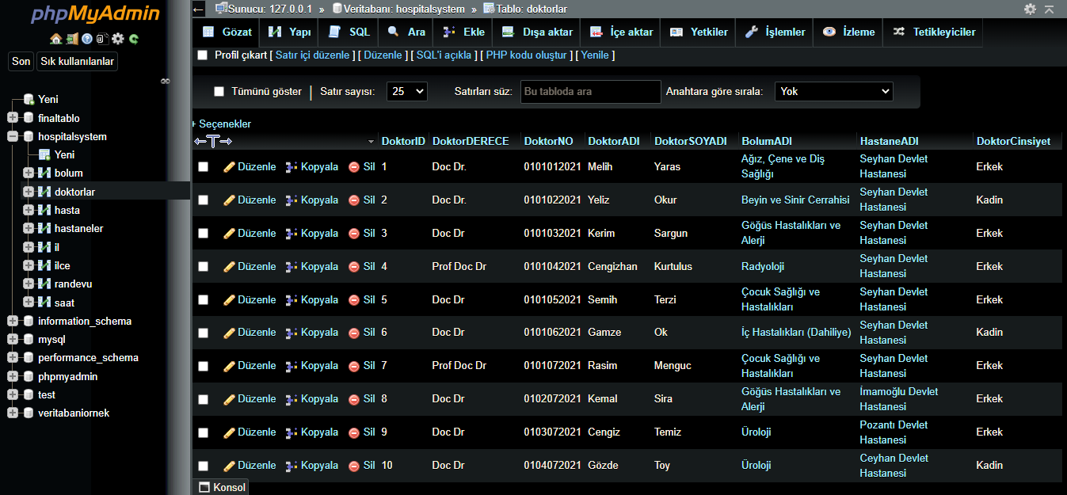
Our database and tables.

Slide 13
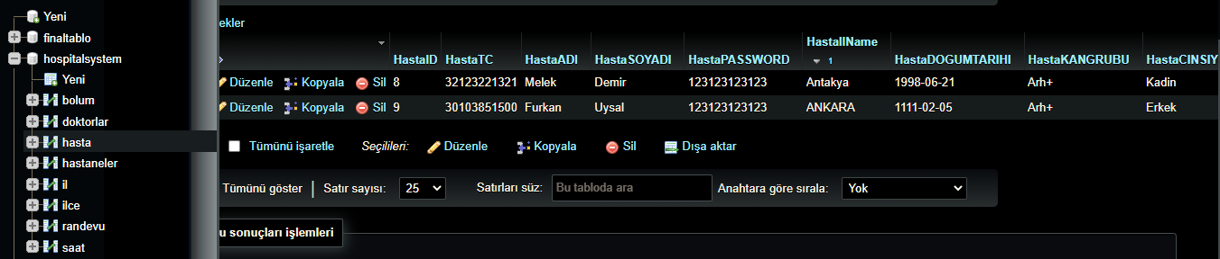
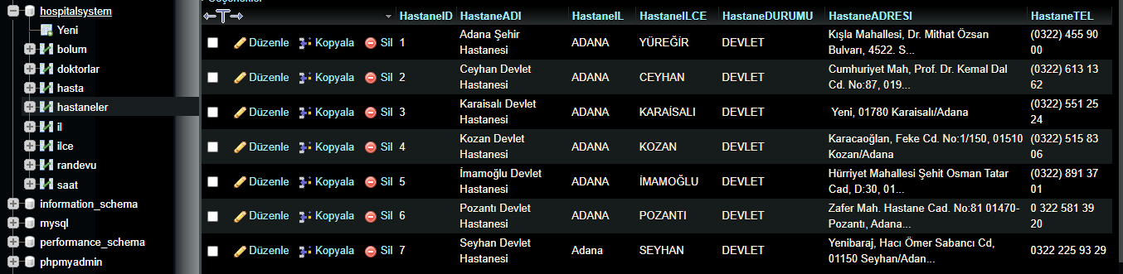
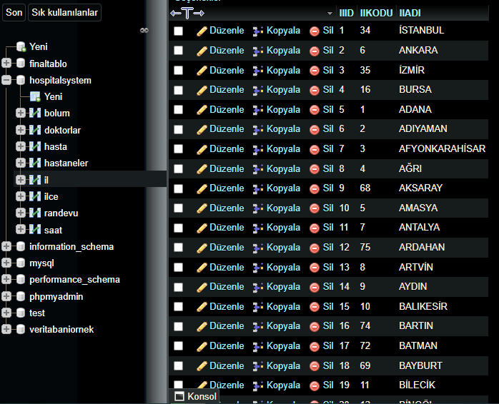

Slide 14
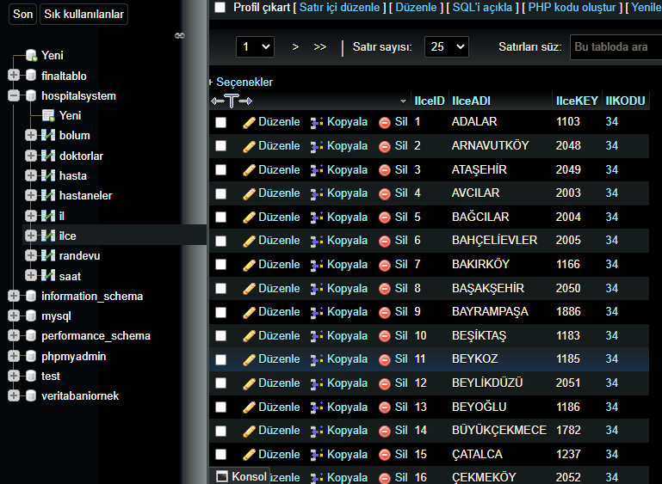
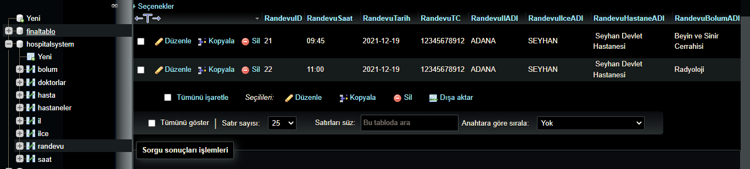
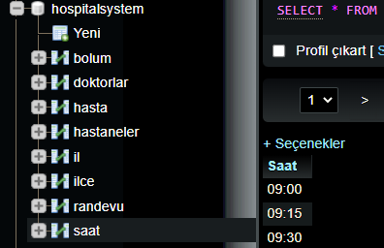
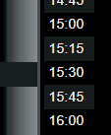

Slide 15
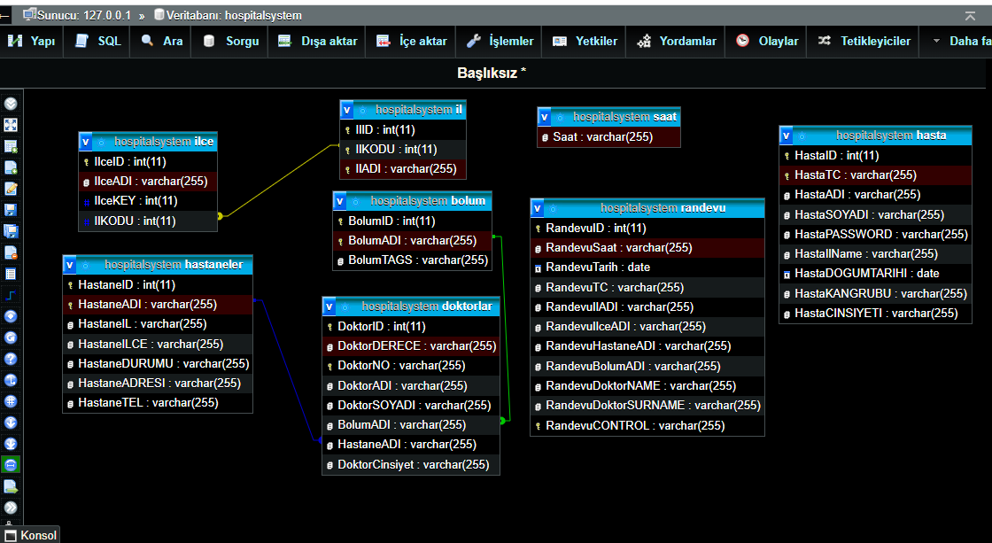
It shows the relationships between the data.

Slide 16
Images related to the operation of the online hospital appointment system program.

Slide 17
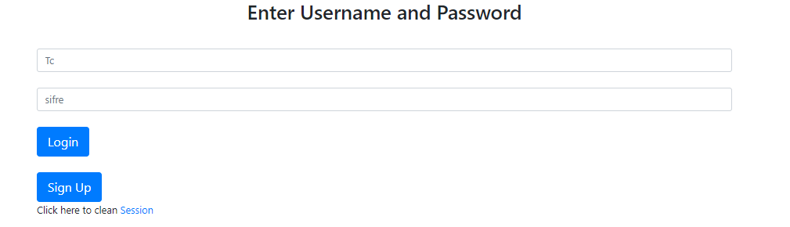

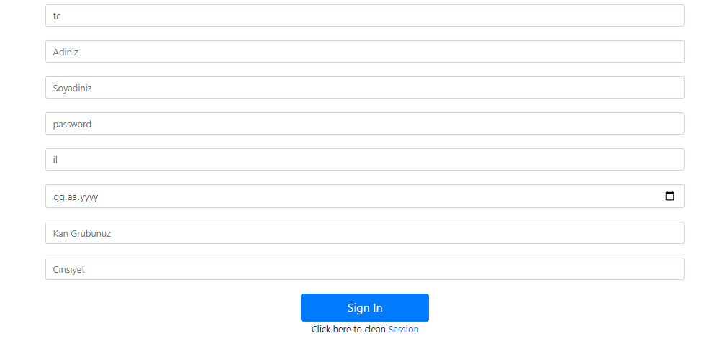
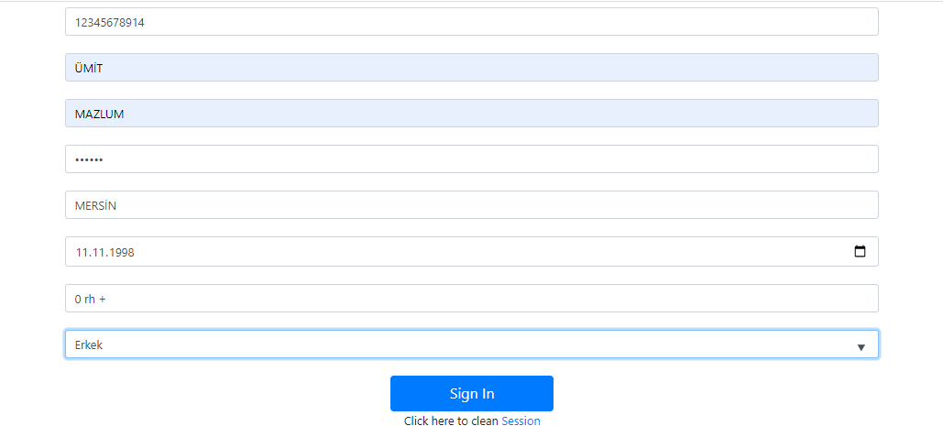

1
(when wrong password is entered.)
2
3
(the system's response when recorded.)
(It is not possible to re-register with the same ID number).
Note: under development

Slide 18
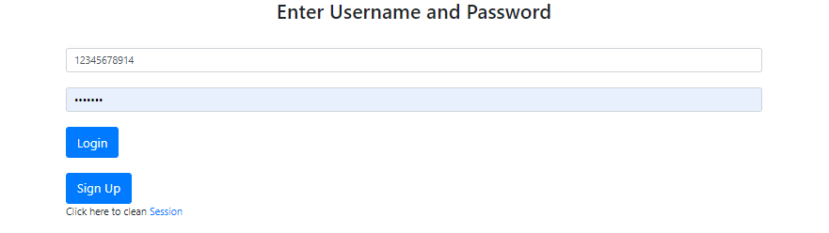
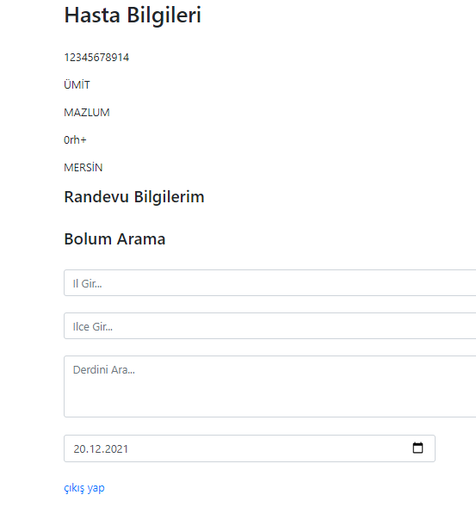
4
5

Slide 19
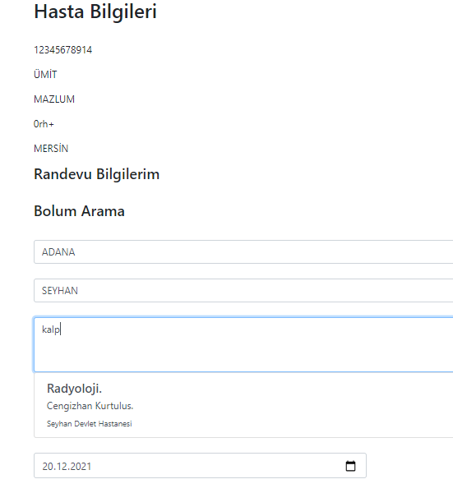
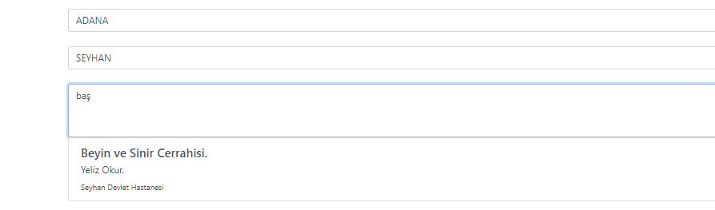
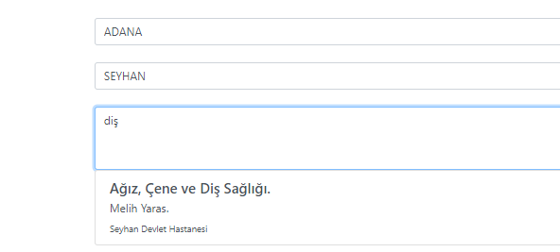
6
The patient enters the keyword related to his/her illness here.
related to other possible diseases.

Slide 20
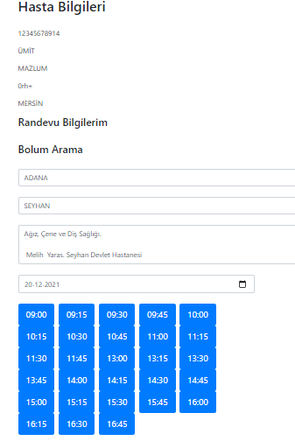
7
the part where the patient can choose the date and time for the appointment.

Slide 21
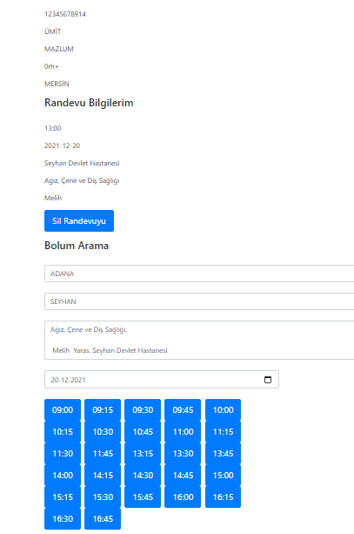
8
Only one appointment can be made from each department, but appointments can be made for the same day from different departments..

Slide 22

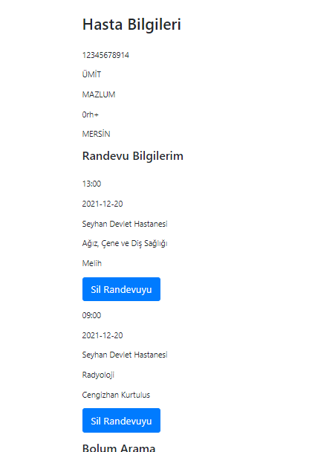
9

Slide 23
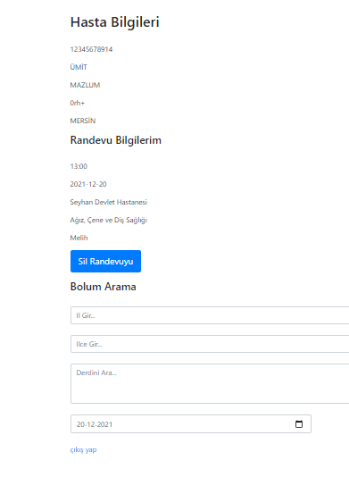
10
(link path to log out.)

Slide 24
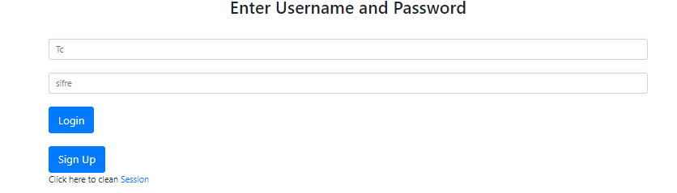
11
12

